Slide 1
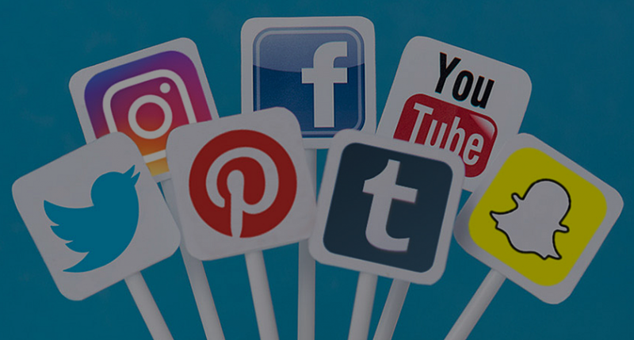
Public relation
Marketing communication
Name:
ID:
Name:
ID:

Slide 2
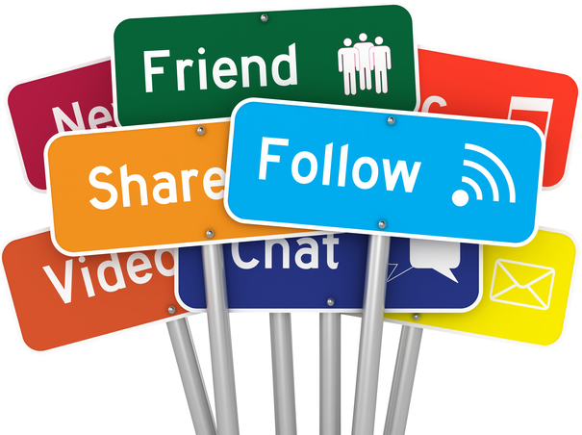
content
Introduction
Research Methodology
Strengthening public relations between the organization and the public
Privatization of public relations organization
The importance of public relations at work level
Conclusion

Slide 3
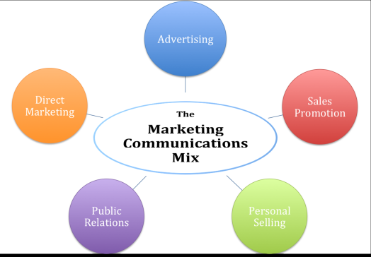
Introduction
One of the most important points in which the general relationship has developed in social networking sites
Public relations became a profession with a scientific body of knowledge.
Each channels of communication has its specific uses, and each has its own advantages
We find that each way is different from the other in relation to the audience to which you relate with it.

Slide 4
effective
marketing
The main objective of the research hypothesis is how to build a strong relationship with the target audience in all areas of the general relationship at the institutional level and the media level of the organization.
That successful communication requires the availability of a set of elements.
The elements are effective for enabling public relations to communicate through social media to build marketing ideas

Slide 5
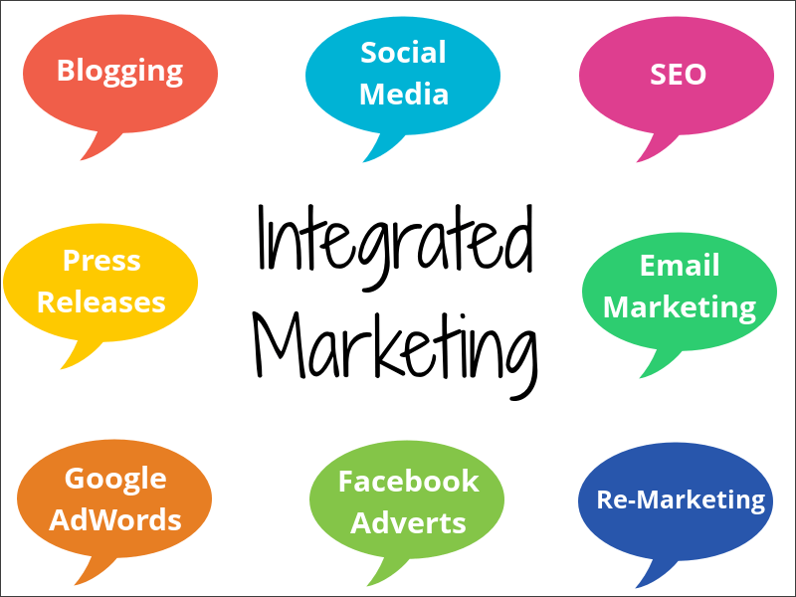
Strengthening public relations between the
organization and the public
The concept of communication can be defined in the light of the nature of its use and the purposes intended
To achieve it behind it and the level of development of the organization is primarily

Slide 6
The importance of PR in communication
That public relations have a major role in the success of the organization and its prosperity significantly
Promoting brand values You can use PR to send positive messages to your target audience in line with your brand image by using the language and ideas that your target customers is responding to it more positively.

Slide 7
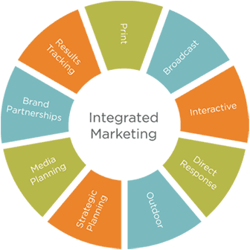
Conclusion
Regarding the Decision of the use of communication in PR social media communicating be made on objectives identified and marketing plan with solve the problem where to focus on activity and efforts which organization is look for it.

Slide 8
Thank you

